Slide 1
Tungsten Products
Guangxi Chentian Metal Product Co., Ltd.

Slide 2
Tungsten Products
1，Tungsten Alloy Radiation Shields
2，Tungsten Alloy for Sports
3，Tungsten Alloy for Aerospace
4，Tungsten Alloy Crankshaft Blocks
5，Tungsten Alloy for Oil Logging

Slide 3
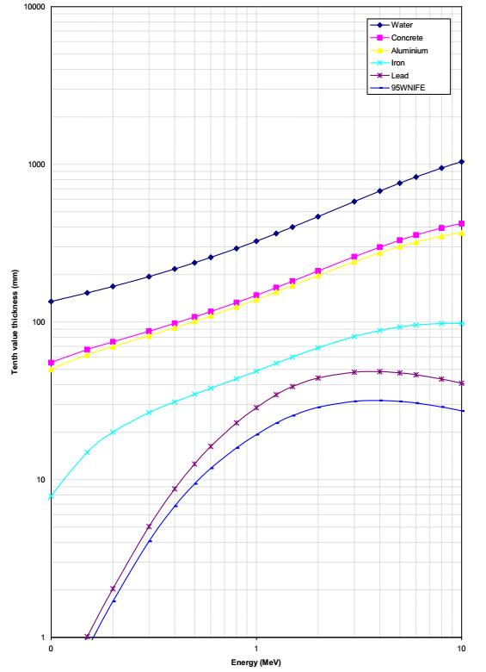
1,Tungsten Alloy Radiation Shields
Graph 1 - Comparative Absorption Data as a Function of Energy
Introduction
Tungsten alloys are not only very dense, but they are also very good at attenuating ionising radiation. This makes them ideal for shielding applications such as in nuclear medicine in the nuclear industry.
The ability to attenuate radiation is often expressed in “tenth layer thickness” - the thickness of a plate required to reduce the transmitted radiation to one tenth of the intensity of the incident radiation; the lower the figure, the better the shielding. The attenuation properties also vary with the incident energy if the radiation.
Graph 1 demostrates gamma-ray absorption characteristics of 95WNiFe and other shielding materials showing tenth-layer thickness (narrow beam/radiation) as a function of incident beam energy. Data supplied by the National Physics Laboratory.

Slide 4
1,Tungsten Alloy Radiation Shields
Introduction
Comparative Absorption Data
Within the tungsten alloy range, the tungsten content varies from 90% to 97% by weight. More tungsten improves the radiation attenuation and so reduces the tenth layer thickness. this is illustrated in Table 1 at a fixed incident γ ray energy (Co⁶⁰), where the absorption data for two of the Guangxi Chentian Metal Product Co., Ltd. products and lead are compared. Also shown are the corresponding half thickness of shielding needed to halve the radiation intensity.
Table 1 - Comparative Absorption Data
 | 90 WNiFe | 95WNiFe | Lead
% tungsten | 90.0 | 95.0 | 0
Narrow bean radiation tenth layer thickness, mm | 24.8 | 24.3 | 38.3
Half thickness, mm | 7.5 | 7.0 | 11.7

Slide 5
1,Tungsten Alloy Radiation Shields
Why Do We Need Tungsten Alloy Radiation Shielding?
With rapid development of medical science, more and more tungsten radiation shieldings are used in our lives. Medical instruments x-ray and nuclear power stations have become widespread and are now affecting all our lives. It is essential that people paid more attention to radiation and even more important for the institutions to protect public from the radiation exposure and to make sure to protect every radiation source of X-ray radiation, gamma radiation (energetic electromagnetic radiation), radiation of alpha particles (helium atoms) beta particles (electrons) and cosmic radiation, etc.
In order to protect patients, doctors, nurses and other people who may be exposed to radiation, sources of the radiation must be safely separated and shielded. It is crucial that holding and delivery instruments for radioactive materials would keep the radiation levels low enough, not to create harmful effects of ionizing radiation such as breast cancer, skin cancer, etc. Lead and steel are the traditional protection materials, but tungsten alloy radiation shielding is without a doubt the best solution. Excellent radiation-absorption and radiation shielding, twice the density of lead and good physical resistance are main reasons to use tungsten alloy radiation shielding.

Slide 6
1,Tungsten Alloy Radiation Shields
Advantage of Tungsten Alloy Radiation Shielding
Experts find that radiation exposure could be reduced by maxing shielding.
The density of a material is related to its radiation protection ability. Higher density means better stopping and absorbing radiation ray . Due to a higher density than most other materials, tungsten radiation shielding has a much higher ability of absorbing and stopping almost rays than others metals such as the traditional radiation shielding - lead. Tungsten radiation shielding greater linear attenuation of gamma radiations means that less is required for equal shielding. Alternatively equal amounts of tungsten shielding provide diminished exposure risks than equivalent lead.
Tungsten heavy alloy is the right material for radiation protection, as its combination of radiographic density (more than 60% denser than lead), machinability, good corrosion resistance, high radiation absorption (superior to lead and steel), simplified life cycle and high strength. Tungsten radiation shielding can provide the same degree of protection as lead whilst significantly reducing the overall volume and thickness of shields and containers. Besides, compared with lead or depleted uranium (DU),tungsten radiation shielding is more friendship for the environments both lead and DU for it is no any toxic.

Slide 7
1,Tungsten Alloy Radiation Shields
Guangxi Chentian Metal Product Co. Ltd. have been manufacturing and offering tungsten related products for more than 20 years, and we have been able to manufacture, export and supply an optimum quality of tungsten alloy radiation shielding. Tungsten radiation shielding in different sizes and specifications according to the need of our esteemed clients are available for us to supply. Our tungsten radiation shielding products are widely used in PET rooms, linear accelerators, HDR rooms, gamma knife, and nuclear power plants.
Key Features of Tungsten Alloy Radiation Shielding :
1. tungsten alloy radiation shield is capable for radiation exposure that could be reduced by maxing shielding.
2. tungsten alloy radiation shield is having higher density therefore it has better stopping power and shielding capability
3. Equal amounts of tungsten alloy radiation shield provides reduced risks rather than equivalent lead shielding
4. tungsten alloy radiation shield is having radiographic density that is 60 % more denser than lead
5. tungsten alloy radiation is having high level of machineability and this is good corrosion resistance
6. tungsten alloy radiation shield is importantly reducing thickness of containers and shields

Slide 8
1,Tungsten Alloy Radiation Shields
Applications of Tungsten Radiation Shielding
The usage of tungsten heavy alloy in radiation protection is not subject to NRC, EPA, or special OSHA regulations, so it has been widely used in nuclear medicine as collimator, isotope container, cancer treatment source holder, etc.
Radioactive source containers
Gamma radiography tungsten alloy radiation shielding
Tungsten alloy radiation shielding block
Tungsten alloy radiation shielding source holders for oil well logging
Tungsten heavy alloy X-ray collimators
Tungsten alloy PET syringe shield
Shielding in cancer therapy machines
Syringe protection for radioactive injections
Tungsten heavy alloy syringe shielding
Nuclear shielding wall
Tungsten Alloy FDG container
Tungsten heavy alloy inspect welds
Nuclear testing equipment
Nuclear power plant shielding
Radiation shielding barrel
Isotope production, transport, and containment
Personal protection equipment for emergency responders
Large container inspection devices
Oncology Isotopic and accelerator based platforms
Pipe-line inspection Gamma
Defense for nuclear submarines

Slide 9
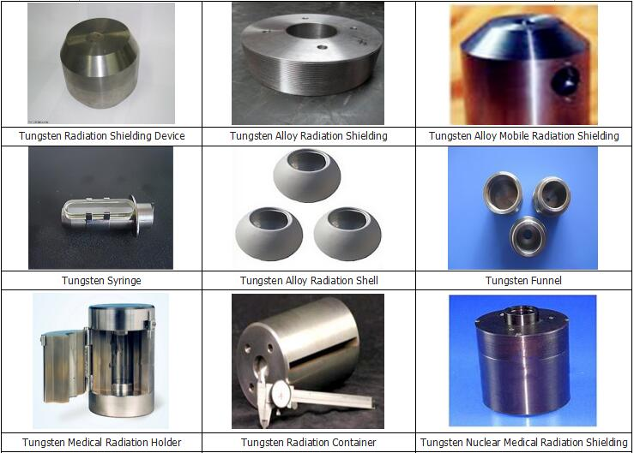
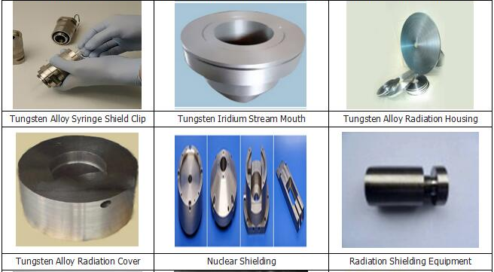
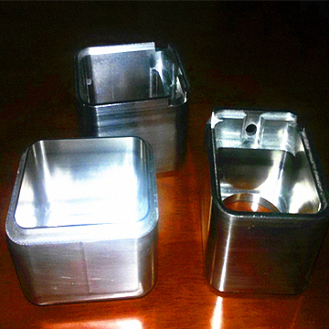
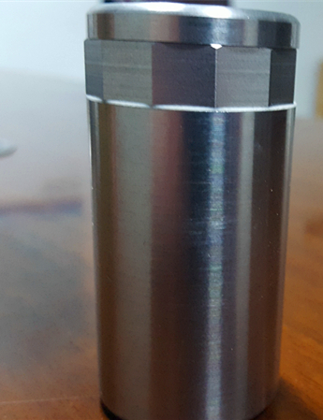
1,Tungsten Alloy Radiation Shields
Applications of Tungsten Radiation Shielding

Slide 10
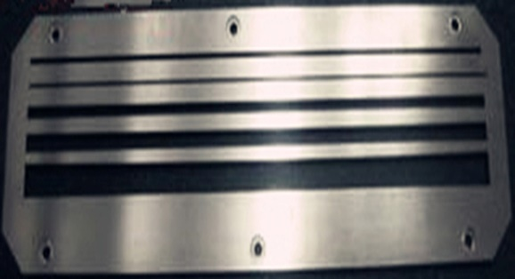
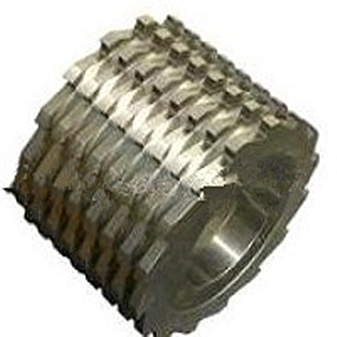
1,Tungsten Alloy Radiation Shields
Nuclear Medicine Tungsten Radiation Shields
What is Nuclear Medicine?
Nuclear medicine is a medical specialty involving the application of radioactive substances in the diagnosis and treatment of disease. Nuclear medicine scans are usually conducted by radiographers. Radiation is an effective tool within nuclear medicine for both diagnostics and treatment of patients. Techniques such as SPECT and PET utilize radioactive materials injected into the patient, which are then monitored by gamma cameras (SPECT) or scanners (PET) to detect the presence of tumours in the body.
The Applications of Nuclear Medicine Tungsten Radiation Shielding
Tungsten alloy has excellent radiation attenuation properties, with thinner thickness but high effective in blocking harmful X-ray and gamma radiation. Tungsten alloy shielding is the best choice in nuclear medicine. And nuclear medicine tungsten radiation shielding is usually used in the nuclear medical equipment , such as collimator, linear accelerator, multileaf collimator,computed tomography,X-ray energy, absorptiometry, and gamma knife.
Why Use Nuclear Medicine Tungsten Radiation Shielding?
The advantages of tungsten alloy:
High radiation attenuation; good shielding capability
Thinner and often lighter than equivalent lead shields
Easy to sterilise and keep clean
Non-toxic
Easily machined with conventional tools
Hard and durable – no need for coating
During design of shielding, tungsten alloy radiation shielding is calculated according to requirements of shield to abate the multiple shielding materials' thickness.
Formula: K = e0.693 d / △1/2
K: Shield weakened multiple
△ 1/2: The tungsten alloy radiation shielding material of the half-value layer values

Slide 11
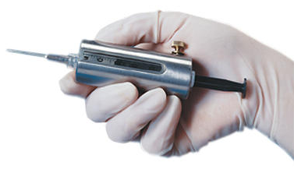
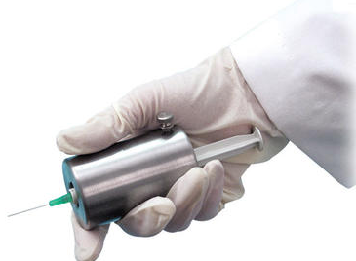
1,Tungsten Alloy Radiation Shields
Tungsten Alloy Syringe Shields
Tungsten Alloy Syringe Shield 3cc:
Introduction:
9 mm thick glass-5.2g/cc gives optimum protection and tungsten alloy syring shield is easily replaced. Fully exposed needle hub allows you to visually check for correct venous insertion prior to injection.
Weight: without glass:
2.5cc: 0.3 lbs (0.14kg)
3cc: 0.36 lbs (0.16kg)
5cc: 0.4 2bs (0.19kg)
10cc: 0.62 lbs (0.28kg)
With glass:
3cc: 0.42 lbs (0.19kg)
5cc: 0.53 lbs (0.24kg)
10cc: 0.77 lbs (0.35kg)
Drawing Tungsten Alloy Syringe Shield 3cc
Introduction:
2 mm solid tungsten flange helps syringe shield the hand when withdrawing liquid from a vial. Flange is easily removed to allow transition from drawing dose to patient injection. 9 mm thick glass-5.2g/cc gives the greatest protection of any glass in any syringe shield and syringe shield is easily replaced. twist-turn and the syringe is held firmly. Tungsten alloy syringe shield offered by us is qualified. We can provide alloy kinds of syringe shield as your requirements.
Material: tungsten
Weight:
3cc: 0.77 lbs (0.35kg)
5cc: 1.06 lbs (0.48kg)
10cc: 1.5 lbs (0.68kg)
PET Pig Syringe Pig/Syringe Shield
PET Pig syringe shield allows the safe transportation and administration of unit dose PET radiopharmaceuticals. The “T” handle on the PET Pig cap allows the unit to be easily lifted out of traditional “ammo can” delivery cases. The syringe shield use of the thermos style handle reduces hand exposure by permitting the PET Pig to be carried to the imaging suite without holding container sidewalls. Prior to injection, the base unscrews, allowing the center portion to be used as a syringe shield. When placed in the optional PET Pig Cradle, patient administrations can be performed with ease and maximum shielding.
Weight: 7.1kg ( 15.6 lbs )
PET Dispensing System Syringe Shield 3/5 cc
The PET Syringe Shield magnetically docks with the PET Dispensing Pig. Designed to accept 3cc and 5cc B-D syringes, syringe shield places the needle inside the vial septum when engaged; the external calibration rod allows the precise volume to be withdrawn without a leaded glass viewing port, where high exposure levels cannot be adequately shielded. We can provide all kinds of tungsten alloy syringe shield as your requirement. Tungsten heavy alloy syringe shield is our leader products.

Slide 12
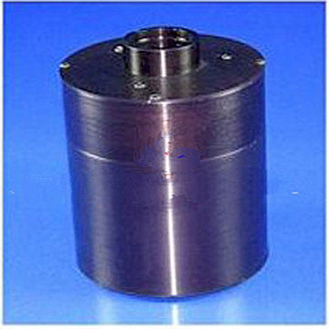
1,Tungsten Alloy Radiation Shields
Tungsten Alloy X-ray Target
Tungsten alloy X-ray target can be subjected to higher loadings than stationary anodes. By rotation of dish-shaped X-ray targets under the electron beam, a new, already cooled part of the target surface is continually used as the focal spot. Moreover, tungsten alloy X-ray target cools down more rapidly by radiating its heat. Far more energy per unit time can therefore be supplied to a tube with an X-ray target in comparison with a stationary anode.
Guangxi Chentian Metal Product Co. Ltd can supply the whole range of Mo alloys and tungsten X-ray targets. Tungsten alloy X-ray targets that are optimally suitable for individual customer requirements, such as mammography Mo X-ray targets and tungsten X-ray targets, which are used from the general medical diagnostic and amigo- cardiograph to computer tomography.
In the past two decades, Guangxi Chentian Metal Product Co. Ltd has been developing components for the latest generation of high performance medical devices in close cooperation with the leading medical instruments suppliers.
For diagnosis, Guangxi Chentian Metal Products Co. Ltd supplys tungsten alloy X-ray target and stationary anodes for diverse X-ray applications. Tungsten alloy X-ray target can withstand extreme thermal stress in temperatures of over 2,000℃. All tungsten products are superior quality and durable, guaranteeing longer life.
Electromagnetic blasting is created by the slowing fast electrons down on the anode. 1% of the affected energy is transformed into tungsten alloy X-ray blasting and 99% into heat. Because of that, components within the X-ray should have high thermal resistance and applied material should possess a highest possible melting point, heat sink capacity, good heat conductivity and a smallest possible vapor pressure.
Guangxi Chentian Metal Product Co. Ltd produces tungsten alloy X-ray target components, made of high performance materials (molybdenum, tungsten, WRe alloys), for the assembly of tungsten alloy target technology, which are used worldwide for picture giving systems.
X-ray target
Fastening elements for X-ray targets
Rotors
Stationary anodes
Cathode components
Detector components

Slide 13
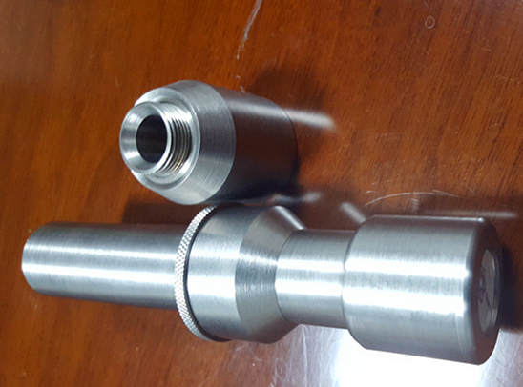
1,Tungsten Alloy Radiation Shields
Tungsten Alloy Collimators
Tungsten alloy collimator is a device that narrows a beam of particles or waves. It belongs to input and output element of optical fiber communicaiton devices. Tungsten alloy collimator can be adopted as linear accelerator and cyclotron in medical treatment. It has a simple structure, through which the fiber radiate light can be converted into parallel light (gaussian beam). So its main fuction is to efficiently maximize the light coupling into the device.
Radiotherapy destroys cancer by directing beams of radiation directly onto the tumor. The beams of radiation require a very fine focus to avoid harming the surrounding healthy tissue. This focus is achieved by using a multi-leaf tungsten alloy collimator, consisting of two rows of very thin tungsten heavy alloy plates, which can be configured to match the dimensions of the tumor exactly.
Tungsten alloy collimator and tungsten alloy X-ray target are made of groundbreaking tungsten alloy X-ray targets components in the medical industry. Tungsten alloy collimator contributes significantly to successful radiotherapy through their high density and high shielding capability against X-rays and gamma rays.
The Classification of Tungsten Radiation Collimators:
There two kinds of tungsten collimators, tungsten panoramic collimators and tungsten directional collimators. Collimators contain and direct the beam of radiation during exposure. This results in improved radiograph quality and safer operating conditions. Tungsten panoramic collimators consist of a stainless steel housing containing two tungsten inserts. The panoramic collimator is constructed with two shields designed to provide a 30 degree panoramic radiation beam. Tungsten directional collimators direct the radiation beam from a side port as a 60° conical side throw. Tungsten alloy shielding for the directional collimator is designed to provide a 50 degree radiation beam and is encased with stainless steel and totally sealed by argon arc welding. The shields are encased with stainless steel and totally sealed by argon arc welding. A wide range of collimators have been developed to meet the variety of applications and techniques used.
Advantages of tungsten alloy collimator:
1. One of the most effective devices for reducing the radiation levels on a job site;
2. Increasing the quality of radiography shots by reducing the scattering radiation around the film;
3. Providing a safer operating conditions for radiographers;
4. Tungsten alloy material is a more effective shielding material than lead. It is an easy handle, non-licensed and very effective shielding material;
5. Do not spark, it is a ideal material for plant operations.

Slide 14
2,Tungsten Alloy for Sports
Due to high density and small volume, high melting point, excellent hardness, superior wearing resistance, high ultimate tensile strength, high ductility, well machinability, non-toxic and environmental friendliness, high impact resistance and crack resistance, tungsten alloy sportscounterweight are more and more popular.
tungsten alloy fishing weights
tungsten alloy billets for dart barrels
tungsten alloy tennis counterweights
tungsten alloy golf weights
tungsten alloy ski weights

Slide 15
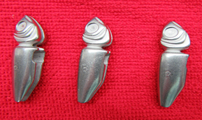
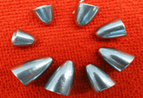
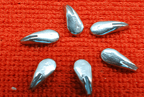
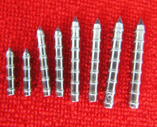
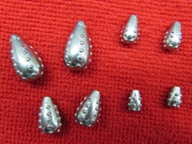
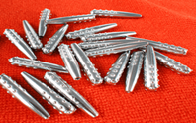
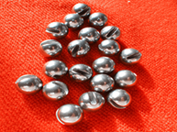
2,Tungsten Alloy for Sports
tungsten alloy fishing weights
Tungsten alloy sports family now also consists of fishing. Tungsten alloy fishing weights and jigs for tungsten alloy sports can be used in both the fresh water and salty water As a general rule, often adopt the lightest jig weight if possible, because the lightest fishing jig permits you to feel the bottom and any cover it contacts. In clear water, lighter weights ranging from1/8 ounce to 1/4 ounce should be combined with light line for more effective and spinning tackle are also necessary. For murky or deep water, more dense cover and heavier jigs about 3/8 to 5/8 ounce are needed, and can be fished on stout bait casting tackle with heavy line. In the case of the windy day, it's hard to maintain contact with tungsten alloy fishing weight to detect strikes, while it will be not the problem if blow a bow in your line and go to have a heavier fishing sinkers.
Chentian Metal Prodcut Co., Ltd. supplies tungsten fishing weights (sinkers) with near 100 styles and various sizes for choice, we can also customize your own design as per your drawing.

Slide 16
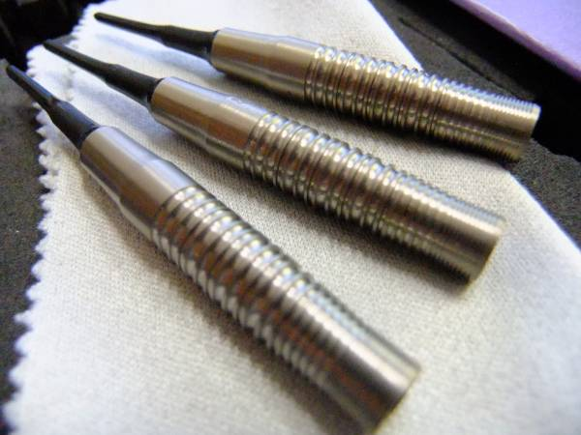
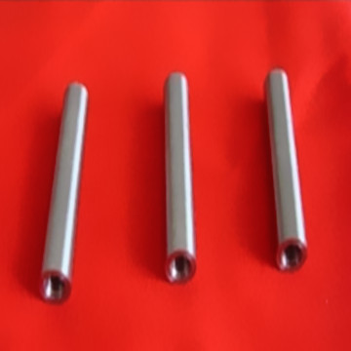
2,Tungsten Alloy for Sports
tungsten alloy billets for dart barrels
"buying a (new) dart" we mean getting a new dart barrel. Nowadays barrels are available in almost every possible shape, with a wide selection of knurl or rings on the surface for a comfortable and safe grip.
Because of technical difficulties with manufacturing, 100% tungsten dart barrels are not available. All "tungsten" darts you can buy are in fact made of tungsten alloy, with Nickel-Iron-Tungsten being the most common one. Because tungsten alloy is now the main material for professional darts we can classify darts as tungsten alloy sports.
Chentian Metal Prodcut Co., Ltd. supplies tungsten alloy billets for making dart barrels and also help produce finished barrels according to your designs.
tungsten alloy billets
tungsten dart barrels

Slide 17
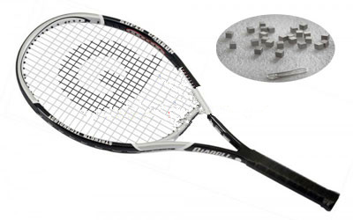
2,Tungsten Alloy for Sports
tungsten alloy tennis counterweights
Tennis player strikes the ball and seeks to achieve as much control as possible with the greatest force applied to the ball. This occurs when the ball is struck at a position on the strings known as the "sweet spot" which is the central area of the strings. Player attempts to hit the ball squarely with the racket head opposite to the direction of flight of the ball. No two players have identical swings and therefore two different players may swing slightly different with the same racket. Furthermore, since the tennis racket weight and overall structure is fixed after it is made; the only way to achieve a different arrangement is to obtain a racket having a different weight or weight distribution. Tungsten alloy sports products allows weights to be easily added at selected points of the racket that would improve a players overall swing. Selected weighting can be used to increase the weight of the head for a more powerful serve, but also to correct imbalances in player's swing. Tungsten alloy sports material is the best possible material in this case.

Slide 18
2,Tungsten Alloy for Sports
tungsten alloy golf weights
Golf only recently became one of the tungsten alloy sports. Golf club comprises a main body of club head that is made of low-density, lightweight and tough alloy, a counterweight slot, a neck part. Tungsten alloy counterweight is placed in the counterweight slot that is shaped as long slot or ring slot. It can be located at the bottom, center or the periphery of the club head's main body. The tungsten alloy sports products can be inserted into one ore more of the counterweight slots. The neck part is welded on one side of the top of the club head main body to make up the golf club head. Golf club balance can be manipulated by adding weights with different gravities or by the changing position of the counterweight slot welding on the club head main body. Each golf club can be than fine-tuned to mach golfer's needs.

Slide 19
2,Tungsten Alloy for Sports
tungsten alloy ski weights
Tungsten ski balance weights is a kind of tungsten alloy products and relate to the technological sector of skis and the associated accessories which allows optimum performance to be achieved in all skiing disciplines. More particularly, the product relates to an assembly consisting of ski, ski boot and associated bindings. One or more weights of variable size are mounted on the ski in order to achieve better balancing of the ski itself and a reduction in the vibrations of its various parts caused by the pressure stresses acting on the zone of bearing contact of the ski with the snow.

Slide 20
3,Tungsten Alloy for Aerospace
Probably the most well known application for tungsten alloy is the aerospace industry, where weights and counterweights are often required to be housed in restricted areas. Tungsten alloy aerospace counterweight and tungsten alloy aerospace balance are the most important parts in helicopter. With significant reductions in size possible, this in turn, leads to greater control of weight distribution. Tungsten alloy is the best choice to produce tungsten alloy aerospace counterweight and tungsten alloy aerospace balance.
tungsten alloy aerospace counterweights
tungsten alloy aerospace counterbalance

Slide 21
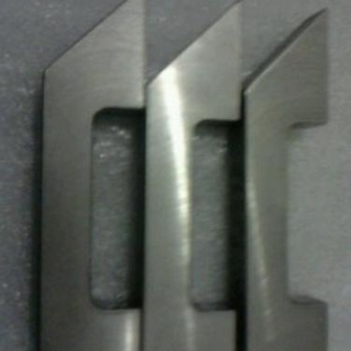
3,Tungsten Alloy for Aerospace
tungsten alloy aerospace counterweights
Tungsten alloy aerospace counterweight in the dynamic components of aircraft engines and propeller systems are highly undesirable. Vibration, caused by mass imbalance of externally rotating components, can be reduced or eliminated by using mass trim weights. Additionally, tungsten alloy aerospace counterweights are incorporated into the pitch control systems of many propeller designs as a failsafe mechanism. During flight the propellers are kept at the correct angle by hydraulic pressure.
Counterbalances to optimize performance. Tungsten alloy aerospace balance offers designers several advantages over conventional balance materials such as lead or steel. The higher density of the alloys permits smaller components to be used, reducing overall system weight. Unlike lead, which can exhibit creep at ambient temperatures, these alloys are stable and so may be used in mechanically stressed positions without the need for additional fabrication and encasement. The tungsten alloy aerospace counterweight and tungsten alloy aerospace balance offered by us are qualified.

Slide 22
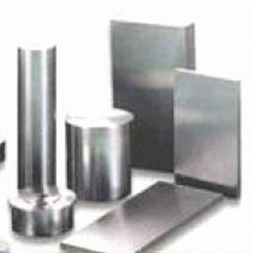
3,Tungsten Alloy for Aerospace
tungsten alloy aerospace balance
Other aerospace applications like tungsten alloy aerospace balance include mass balances in satellites and helicopter rotor blades and in gyroscopic controls for missiles and avionics. In contrast to their vibration damping applications, these materials are also utilized, in the cockpit, to exaggerate the required vibrations in stall-warning shakers for control columns. Similarly, the advent of fly-by-wire controls has introduced small quantities of tungsten alloys into flight control joysticks, in order to increase stick inertia and therefore reintroduce some of the "feel" that is present in traditional controls, which use mechanical linkages to the elevators and ailerons.
In addition to their incorporation as tungsten alloy aerospace counterweights and tungsten alloy aerospace balances, tungsten alloy contribute to aircraft fabrication and repair operations. To deaden the vibration caused by rivet guns, bucking bars ("riveting dollies" or "hand anvils") are used to absorb the force. The vibration can result in damage to nerves, muscles and bones in operators' hands causing Carpel Tunnel Syndrome (Vibration White Finger). Many aerospace companies now reduce the bad effects by using tungsten balloy aerospace counterweight and tungsten alloy aerospace balance.
Ever more rapid long-distance transport of passengers and goods with a concurrent reduction of fuel consumption and emission of pollutants is one of the main demands of today's aerospace industry. Tungsten alloy aerospace counterweight and tungsten alloy aerospace balance made of Tungsten Alloy high performance materials are key elements for future generations of civil supersonic and wide-bodied airplanes, hypersonic aircraft and high performance planes. High-temperature materials facilitate pioneering innovations in the area of propulsion systems, such as aircraft turbines and rocket propulsion, as well as hot outer skin structures of hypersonic aircraft.
Increasing the gas inlet temperature in gas turbines significantly contributes to more energy efficiency in aerospace. Materials have to meet high demands such as hot-gas corrosion resistance, low thermal expansion, high creep resistance and superior fatigue properties.

Slide 23
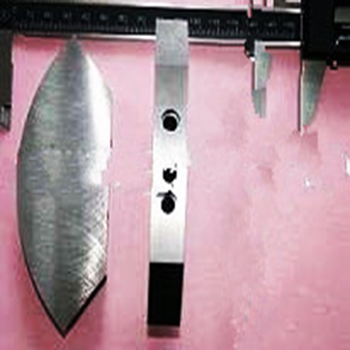
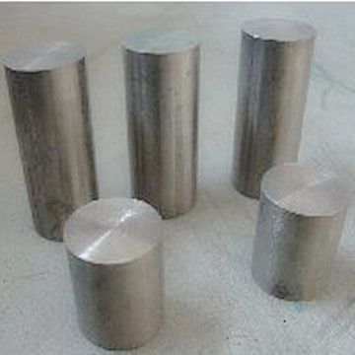
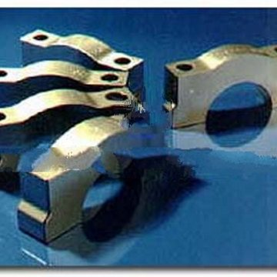
4,Tungsten Alloy Crankshaft Block
Tungsten alloy crankshaft block, commonly called crank, is the part of an engine which has the function of translating reciprocating linear piston motion into rotation with the component of "crank throws" or "crankpins", It typically connects to a flywheel to reduce the pulsation characteristic of the four-stroke cycle, and sometimes there is a tensional or vibration damper at the opposite end for the purpose of reducing the torsion vibrations caused along the length of the crankshaft by the cylinders farthest from the output end acting on the tensional elasticity of the metal. The product is grinded to increase the mixture flow and has a special shape to reduce turbulences inside the crankcase.
The application of tungsten alloy crankshaft block is an exercise in compromise. Depending upon the engine's number of cylinders, crank configuration, and firing order, the mass properties and location of counterweights can vary. Counterweights can balance dynamic loads and couples, it can be used to alter tensional shaft dynamics, and they can be used to reduce main bearing radial and pin bending loads.With a crank design that has limited throw clearance in the sump, like an F1 engine, using a counterweight material with high density (like tungsten) minimizes the radial space needed for a given counterweight.
From a technical point's view, no engine regardless of the application can benefit from balancing. As tungsten crankshaft has high density, so adding tungsten alloy crankshaft block balance weight into the racing car has good effected in optimizing the performance of the racing car during the racing progress. it contributes to the better control of the car's movement.
Tungsten alloy crankshaft block often used to counterweight. The tungsten crankshaft block counterweight means that the sum of all the forces is roughly equal to zero at any point in the assembly's rotation, of which the operation is done by the tungsten alloy crankshaft block counterweights. It is critical that the crankshafts must be balanced to customized rod and piston combination. The product provided by us are qualified.

Slide 24
5,Tungsten Alloy for Oil Logging
What Is Tungsten Alloy Oil Logging Counterweight?
Usually, when it comes to environmental or geotechnical studies about groundwater, mineral, oil and gas exploitation, it is necessary to utilize tungsten alloy well logging counterweight to perform well logging, and analyze stratum situation exactly when drilling boreholes.
Appliance for Tungsten Alloy Oil Logging Counterweight:
Because oil logging needs to enter the earth as deeper as possible to get the characterization of wells, high-performance logging facility is required, and tungsten alloy well logging counterweight should be heavy and firmer enough, to balance out much more upward resistance and enhance the downward impulse force. In fact, tungsten alloy works as counterweight for the whole part.
Tungsten heavy alloy (WHA) is an excellent casing material for oil logging counterweight down-hole logging of oil wells. Casings must be sufficiently heavy to readily sink through materials such as barite mud and strong enough to withstand the hydrostatic pressure of this harsh environment. Most designs of tungsten alloy oil logging counterweight are highly machined for sensor and window positioning. Mechanical properties are very significant to the survivability of tungsten alloy oil logging counterweight rather large components.
Because of high density as 18.5g/cm3 max, hardness as 36 HRC max, high wear-resistance, high impact resistance and excellent durability, tungsten heavy alloy (WHA) is very suitable material for oil logging counterweight down-hole logging of underground water, oil and gas, etc. Special mechanical property is overweight large component in tungsten alloy oil logging counterweight.
Tungsten heavy alloy related to petroleum industry we can offer various tungsten heavy alloy counterweight, such as tungsten alloy oil logging counterweight, also we would like to design the drawing or manufacture concrete products according to customer's special requirements. Tungsten alloy oil logging counterweight we offered are in pressed & sintered blanks large enough to yield the desired component or machined components to customer's specifications.
Price of tungsten alloy oil logging counterweight will be offered based on size, density, quantity, hardness, and any other specific requirements.

Slide 25
Thank You
Guangxi Chentian Metal Product Co., Ltd.
Add.: Luzhai Industrial Park,
Liuzhou,Guangxi,China
TEL: +86 772 3600529
FAX: +86 772 6811659
http://www.gaungxitungsten.com
kjgao@guangxitungsten.com

